Slide 1
Linux device driver
Day 10 PPT
-SUBITHRA s

Slide 2
Linking two files and executing
Create one .h file for defining the declaration –add.h
Create one .c file for defining the definition --add.c
Create another .c file for the main function --addition.c
Commands for linking file and executing:
gcc -c add.c
gcc -c addition.c
gcc –o exe_add add.o addition.o
./exe_add

Slide 3
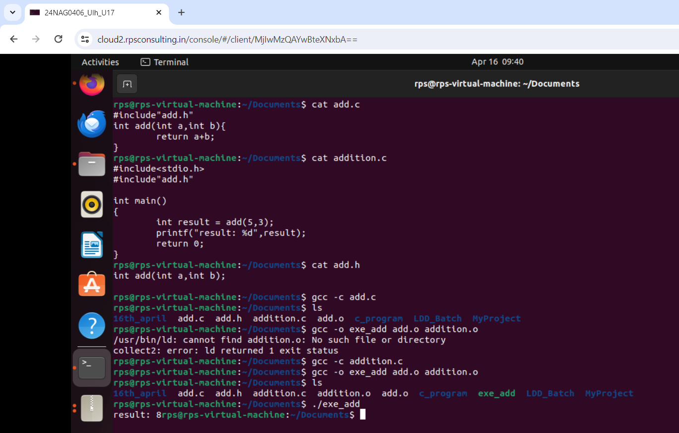
Linking two files and executing

Slide 4
gdb
break <line_number>: set a breakpoint at the specified line number.
run: start executing the program until a breakpoint is reached or the program terminates.
list: show the source code around the current line.
list <function_name>: show the source code of the specified function.
print <variable>: print the value of the specified variable.
info locals: show the values of all local variables in the current stack frame.
backtrace: print a backtrace of the stack.
quit: quit gdb.
help: get help on gdb commands.
help <command>: get help on a specific gdb command.

Slide 5
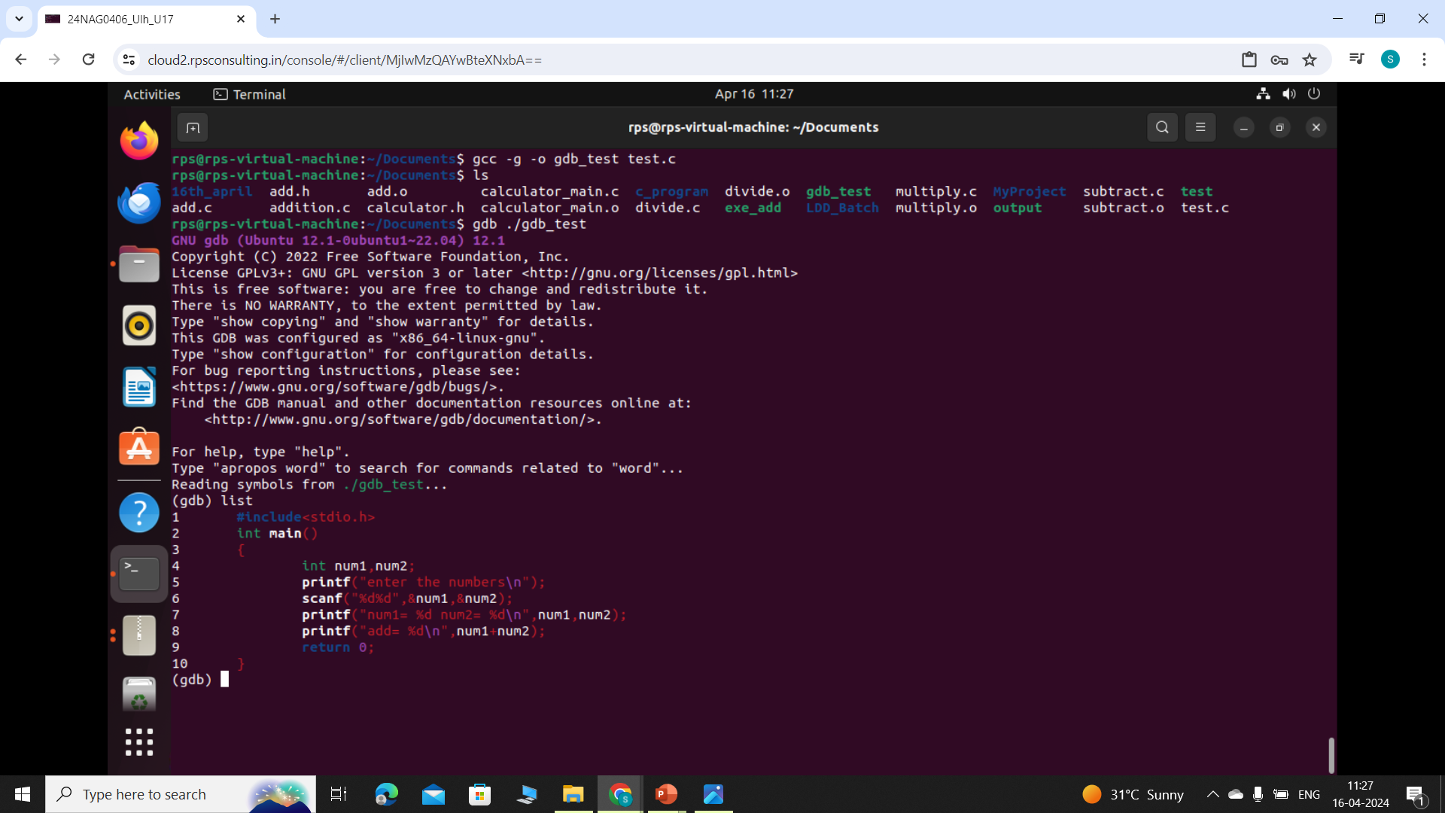
gdb

Slide 6
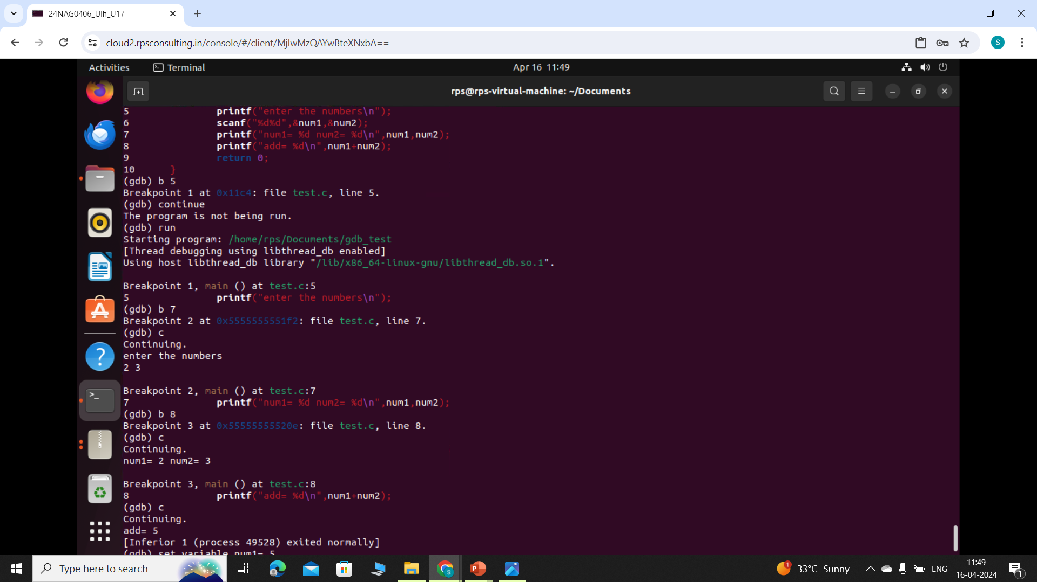
gdb

Slide 7
MAKEFILE
out.o: src.c src.h
$@ # "out.o" (target)
$< # "src.c" (first prerequisite)
$^ # "src.c src.h" (all prerequisites)
%.o: %.c
$* # the 'stem' with which an implicit rule matches ("foo" in "foo.c")
also:
$+ # prerequisites (all, with duplication)
$? # prerequisites (new ones)
$| # prerequisites (order-only?)
$(@D) # target directory

Slide 8
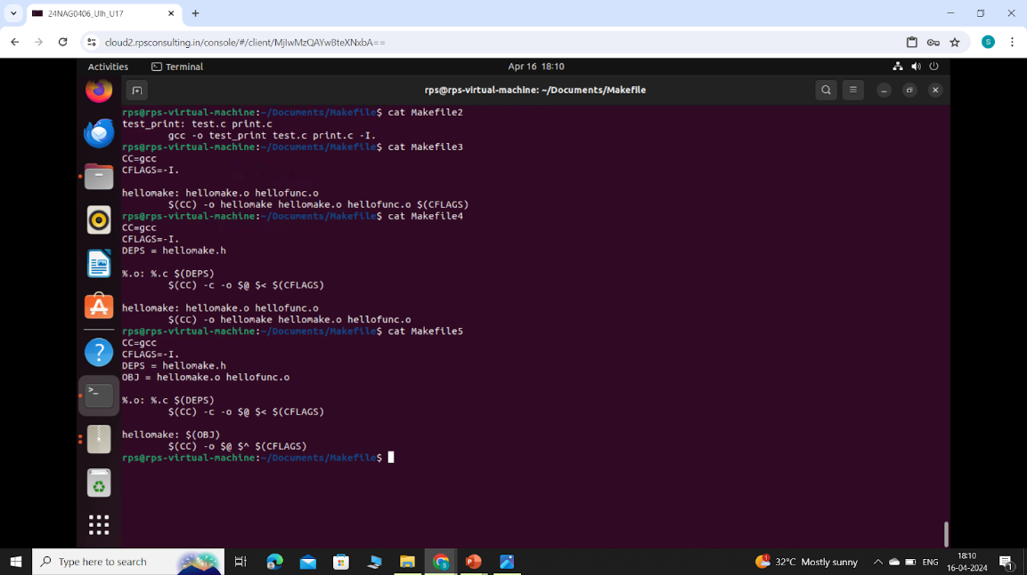
MAKEFILE

Slide 9
THANK YOU

